Slide 1
Using ICTs and Innovative Communication to Assist Communities for Pandemic Preparedness
Cecile M. Lantican , PhD
Country Communication Director, FHI360 Lao PDR

Slide 2
Our Work
Our EXPERTISE addresses major development issues:
agriculture and fisheries, environment, health, education, private and civil society, governance, economic development, technology, youth, research.
We are committed to PARTNERSHIPS at every level.
Our multisectoral APPROACH enables us to create lasting impact to individuals, communities and countries we serve.
We believe that SUSTAINABILITY comes from building the capacity of individuals, communities and countries to address their needs.
Notes:
Across the globe, in more than 60 countries, FHI360 addresses major development issues, such as agriculture and fisheries, environment, health, education, private and civil society, governance, economic development, technology, youth, research.
We are committed to PARTNERSHIPS at every level.
Our mult-isectoral APPROACH enables us to create lasting impact to individuals, communities and countries we serve.
We believe that SUSTAINABILITY comes from building the capacity of individuals, communities and countries to address their needs.

Slide 3
Mrs. Nga, 48 years old, has been raising shrimps in inside the Xuan Thuy national park.
“I don’t know climate change. I know that the weather has changed. When I was young, the weather was consistent. Today, the weather has become extremes.”
Notes:
I would like to begin my presentation with two Vietnamese coastal villagers ----
Mrs. Nga, 48 years old, has been raising shrimps inside the Xuan Thuy national park.
“I don’t know climate change. I know that the weather has changed. When I was young, the weather was consistent. Today, the weather has become extremes: if it is cold – too long cold months; if it is hot – too long hot season.”
I asked, what do you feel when weather changes? “I feel, head ache, but I don’t get sick. No need for me to see a doctor. If I get serious, I will choose to go to the hospital in Hanoi, not here because the district hospital is not complete.”

Slide 4
Mr Han is into earthworm raising (vermicomposting)
“People at my age, particularly the older ones get sick of influenza when the weather suddenly changes. But I am not worried of influenza; I can buy medicine at the pharmacy.”
Notes:
Mr Han is into earthworm raising (vermicomposting) for his use and to supply to other people in the village.
“People at my age, particularly the older ones get sick of influenza when the weather suddenly changes. But I am not worried of influenza; I can buy medicine at the pharmacy.”
Mr. Han was not worried of seasonal influenza, but his living quarter is attached to an extended room where he raises his earthworms. The bed (growing medium) where he grows his worms was made of animal dung, rice straw, kitchen scraps and other litters from his backyard. It is kept moist and damp -- conditions favorable to fungus, bacteria and viruses.

Slide 5
What is common between a pandemic outbreak and climate change?
No boundaries
Event
Crisis
Emergency
People at risk
Response
Notes:
Our projects in Lao PDR deal with changing the behavior of people toward infectious diseases to avoid possible pandemic outbreak. Looking at pandemic outbreak and climate change within the spectrum of disaster preparedness ---
Both recognize No boundaries
These are Events --- that are unusual and unexpected and may happen anytime. When the happen --
There is Crisis that poses challenge beyond the organizational resource capacity of the government of a particular country.
There is Emergency – that may create chaos.
People are at risk .
The situation calls for a whole society approach to disaster preparedness that should gain the support and collaboration among multi-sectoral actors and the communities.
Why did I introduce Mrs Nga and Mr Han? It is because in their context – they both face the risk of a pandemic threat and climate change; their health is at stake as they continue to live in their present situation.
While this presentation does not directly discuss communication about climate change, but it talks about communication – principles, approaches and strategies that are applicable in changing people’s behavior to sustainably adapt to changing climate trends.

Slide 6
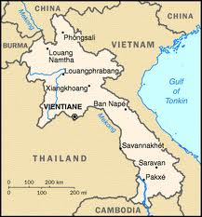
Lessons from the field experiences of FHI360
Communications in Change for Infectious Diseases in the Mekong Sub-region (MID-BCC)
PREVENT
Notes:
Since 2006, FHI360 in Lao PDR in has been working on community initiatives through community engagement, education and planning to enable people and local organizations to take preparedness actions and reduce the impact or a pandemic /disaster event.
Our approach is muti-level partnership with national and local governments and coordination with other stakeholders to implement or put into actions the country’s preparedness plans in communities facing greater risk.

Slide 7
Our strategy : Community-level communication
1. Strengthening communication among community networks
2. Strengthening the communication capacity of community leaders and health volunteers
3. Drawing out community decision making though participatory action research
4. Mobilizing community participation in risk reduction

Slide 8
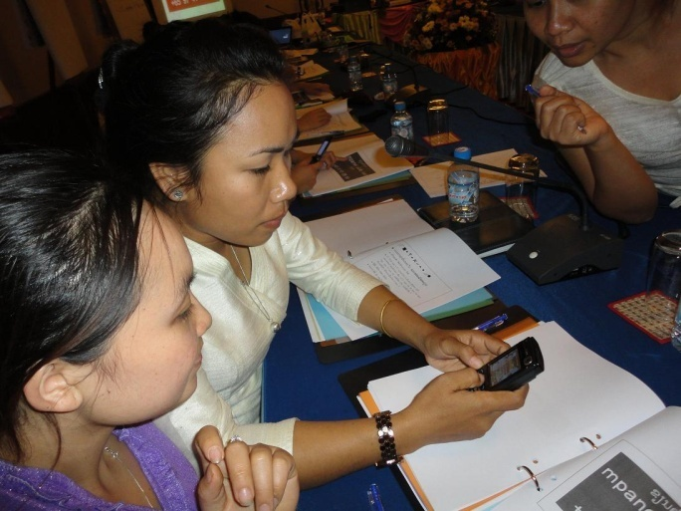
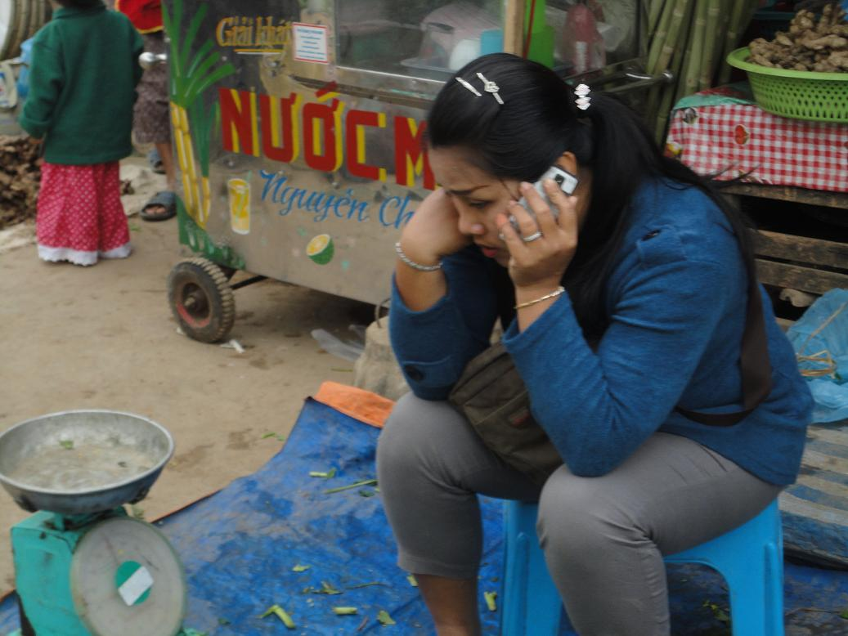
1. Strengthening communication among community networks
The Lao Women Union is a mass organization recognized by the government with its over 1,000 million members all over the country.
Trained Lao Women Union leaders in using SMS technology to monitor cases influenza-like illness in poultry and human.
Mobilized Lao Women Union members in SMS-based price monitoring of poultry in twinned provinces of Savannakhet (Lao) and Mukdahan (Thailand)
Notes:
We trained Lao Women Union leaders in communities in using SMS technology to monitor cases influenza-like illness in poultry and human.
Some of the questions that were fed via SMS ---
On human health ---
Which of the symptoms have you noticed among your friends, family, villagers during the past week if any?
Have you personally seen this past week any of the following diseases? ( flu, malaria, dengue, none)
Which animals have you observed dead in your village this past week? (chickens, ducks, pigs, buffalo, other birds)
Which animals have you observed sick in your village this past week? (chickens, ducks, pigs, buffalo, other birds)
Today, Lao Women Union members are participants in SMS-based price monitoring of poultry in twinned provinces of Savannakhet (Lao) and Mukdahan (Thailand). This is an initiative in partnership with FAO to determine abrupt changes in prices of poultry, eggs and swine which may indicate potential outbreak and movement of dead or sick animals across the border.

Slide 9
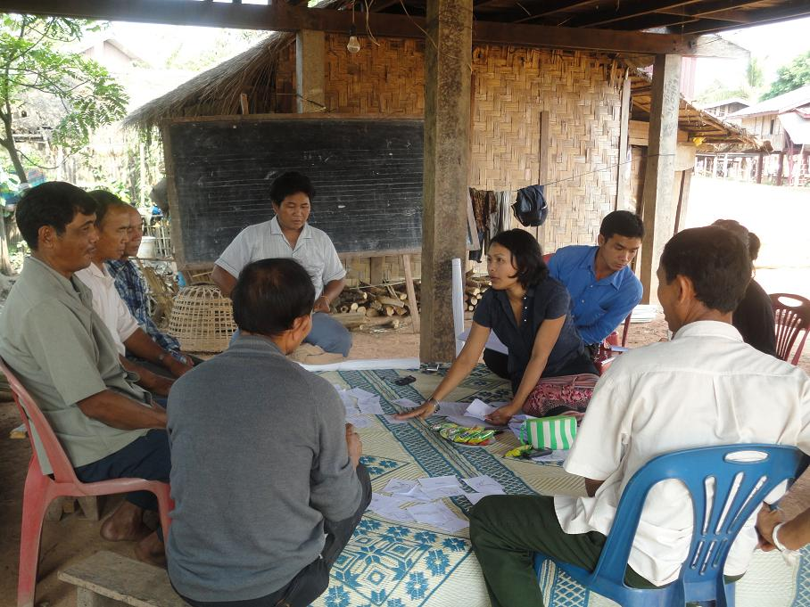
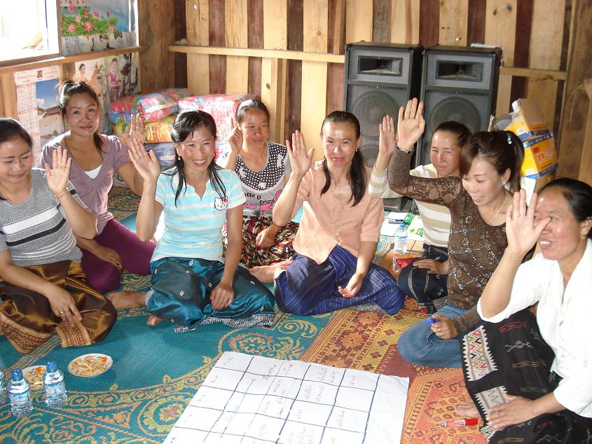
2. Strengthening the communication capacity of community leaders and health volunteers
IPC skills of community leaders to become trusted sources of information
Communication planning and advocacy for pandemics to get support from their local leaders
Provision of advocacy tools, messages and materials

Slide 10
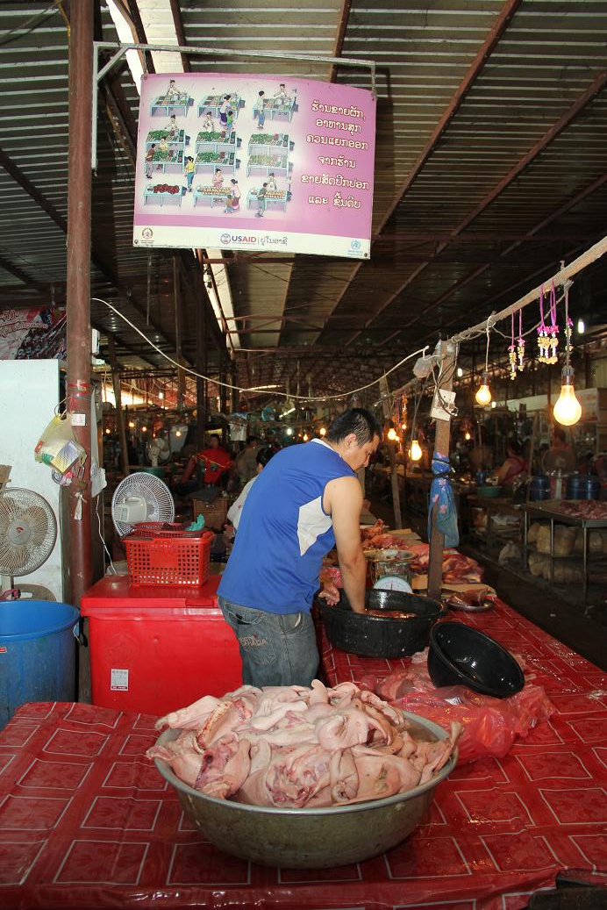
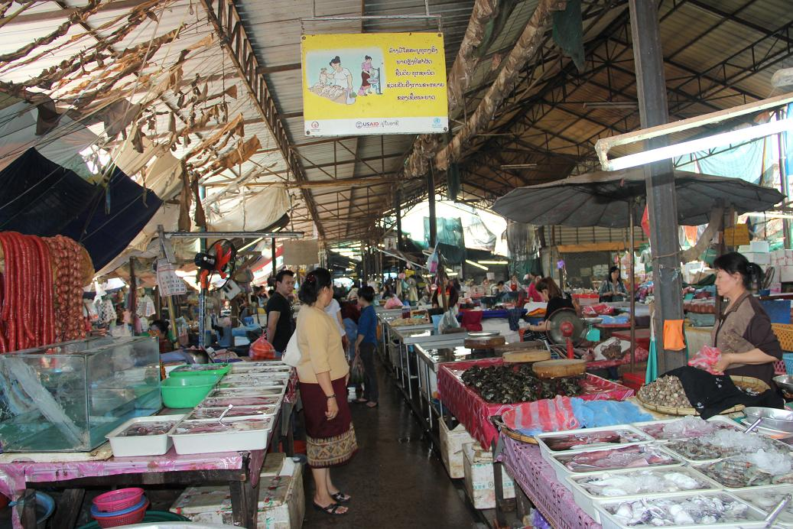
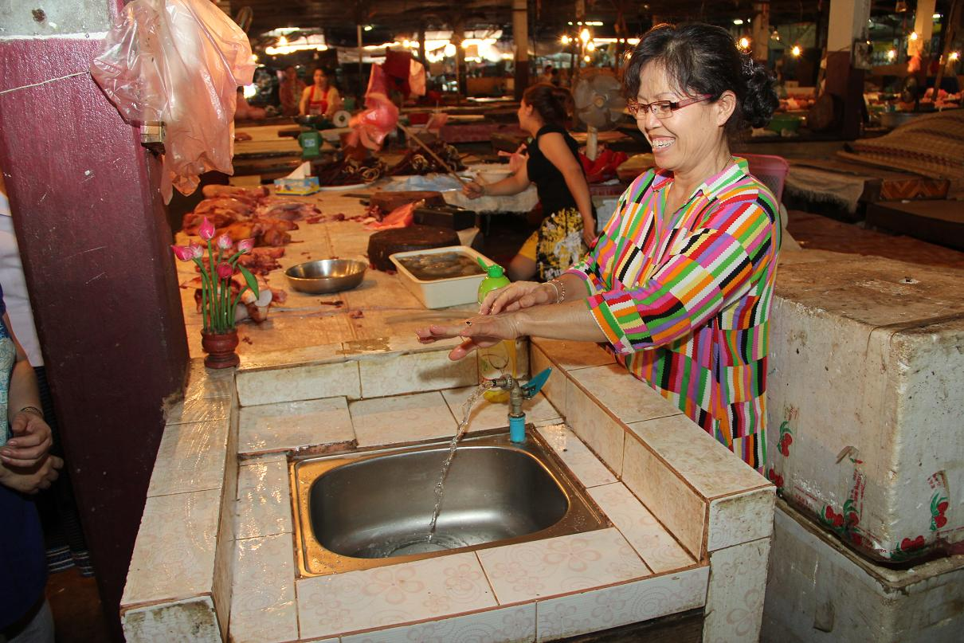
4. Mobilizing community participation in disease risk reduction
Mobilize district/ commune market administrators, vendors, traders and animal/poultry meat slaughterers to promote hygiene and sanitation.

Slide 11
Our monitoring and evaluation revealed
Most likely to report to…
Improved the interpersonal communication skills of community leaders and village veterinarians
Notes:
Based on the results of the KAP studies in 4 years, people will likely report potential outbreaks to the village chief and the animal health worker.

Slide 12
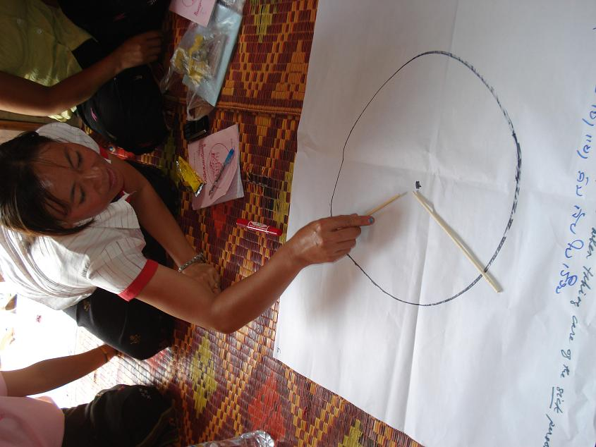
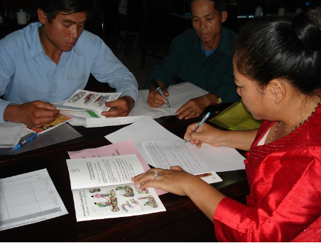
3. Drawing out community decision making though participatory action research
Explored participatory action research (PAR) with communities to identify their problems and find solutions to these problems as well.
Notes:
A barrier to practice recommended biosecurity measures in avian influenza risk reduction is lack of resources. Fencing and separation of poultry were behaviors that were not practiced by poultry farmers because of the cost implication. But our lessons from the PAR would tell us that communities may be able to find solutions to their problem as one. Village participants in the PAR employed one village-one poultry approach.

Slide 13
Results of Community Participatory Action Research
Improvements in Key Behavioral Areas:
Reporting
Quarantine
Separation
Night-time Housing
Fewer Poultry
Brought into Village
Provide Clean Feed/
Water
Notes:
Let’s look at the results. We found that villagers were able to successfully implement several kinds of activities as a village .
A greater willingness to report poultry deaths to the Village veterinary worker - one of the benefits that we noticed from the intervention was the Village veterinary volunteer developed a stronger role within the villages and villagers learned to approach him for problems and issues regarding poultry.
We actually found that most of the villages didn’t really need to bring as much poultry from outside as they thought and that most of their poultry needs could be satisfied from within the village. Other actions they were able to take (that improved from baseline to end line) were separation of sick poultry, quarantining new poultry, providing clean water and feed for their poultry, and night time caging. In addition, awareness of the AI Hotline showed significant improvement.

Slide 14
Lessons learned
Ensuring communication effectiveness in engaging community participation rests on critical interventions:
Resource/funds availability
Engaging community leaders and influentials
Fostering networks that mobilize social support
Involving the community in the communication planning process, a forum that offers them the opportunity to give input into decision making about their current practices

Slide 15
Communication
Risk
Decision making
Practice
Adaptation
Notes:
Another lesson that we learned - People may be poor, but not helpless and dependent.
They take care of their lives, concerns and decisions.
Before I end my session, I would like to pose these questions for you to think about.
How can we harness the power of communication to enable Mrs Nga and Mr Han understand that their health and personal well being are at risk of change in weather ? Or the technical jargon of climate change?
How do we make use of communication to influence their decision to change their behavior and practice to value and safeguard their health as they value their livelihood , in order for them to sustainably adapt to climate change?
As Christiana Fuigeres pinned to the wall in her video message during the opening of this conference, how do we connect the dots (including health which I think one of the dots) in our programming and implementation so that we will make a difference and better improve the well –being of Mrs Nga and Mr Han?

Slide 16
Thank you!
Follow us on http://mekong.aed.org

