Slide 1
Regional Laboratory Network
Pawin Padungtod
Regional Project Coordinator
Emergency Center for Transboundary Animal Diseases
FAO Regional Office for Asia and the Pacific

Slide 2















Acknowledgement
National Animal Health Authorities
International Partners
FAO Officers
2

Slide 3
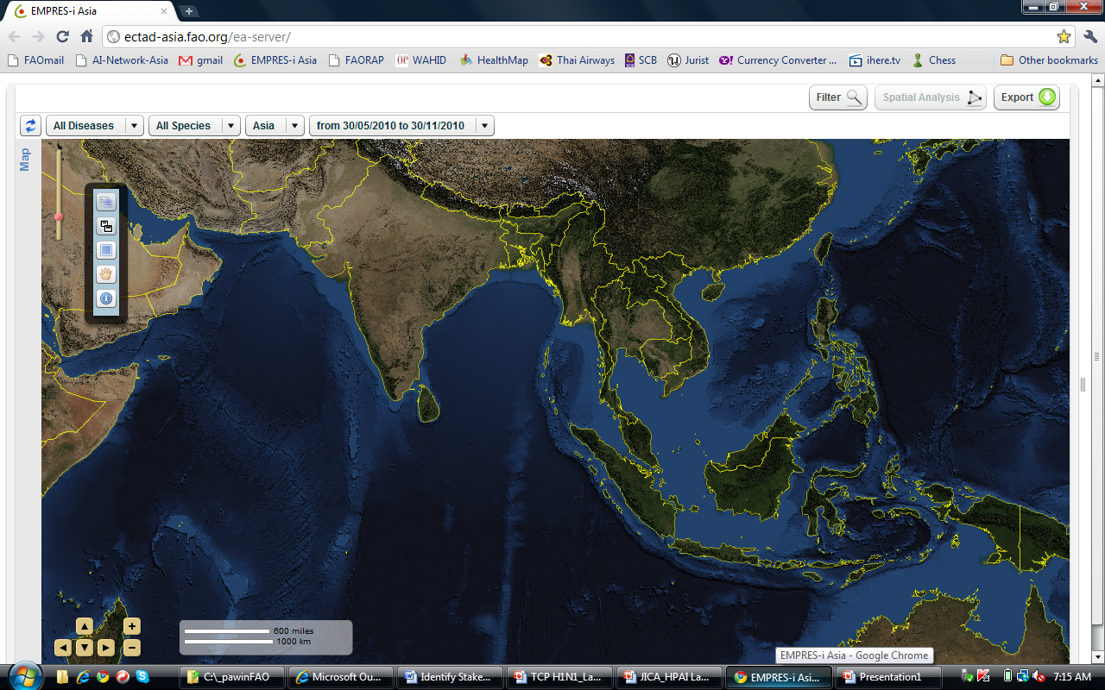
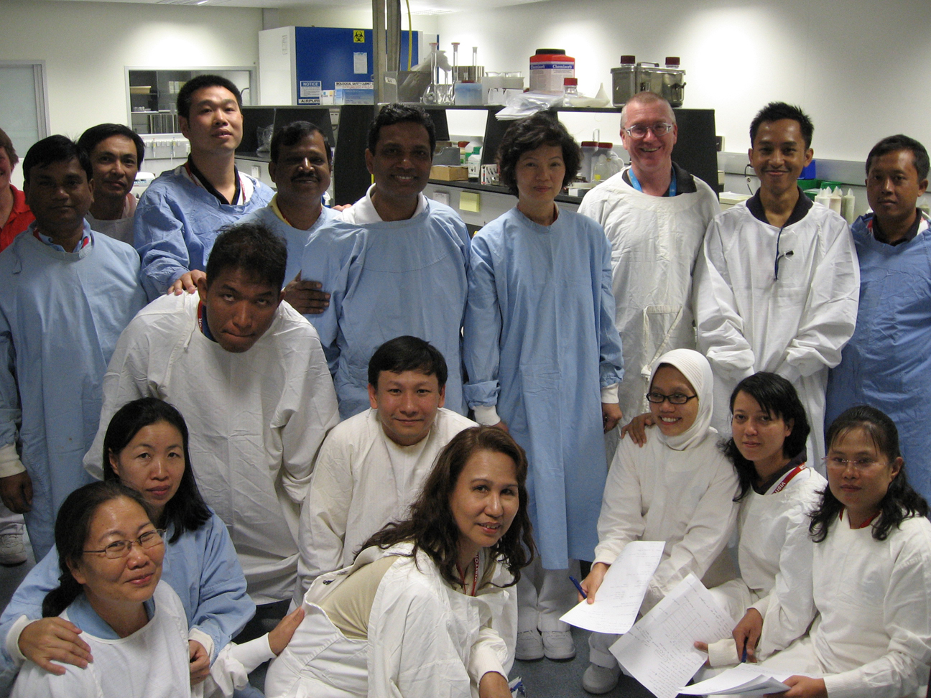
Regional Laboratory Network for Animal Influenza Diagnosis in SE Asia
Focal person in each national laboratory
International reference laboratory (AAHL)
Regional Reference
Laboratories
Key Laboratories
Network Laboratories
3

Slide 4
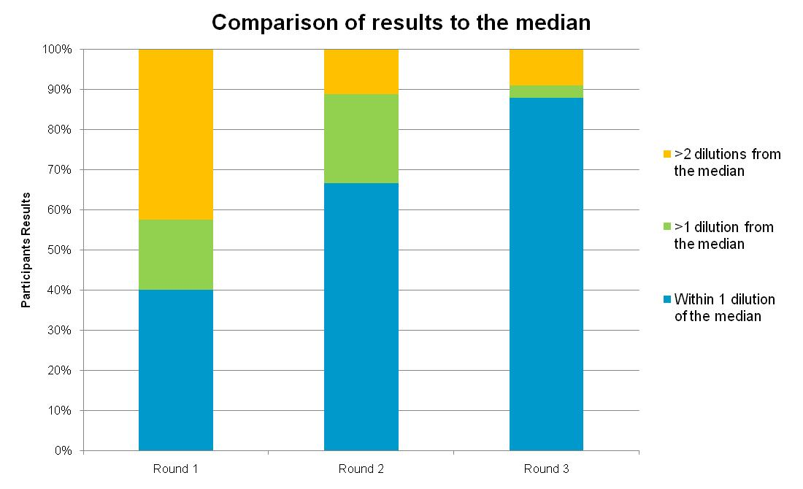
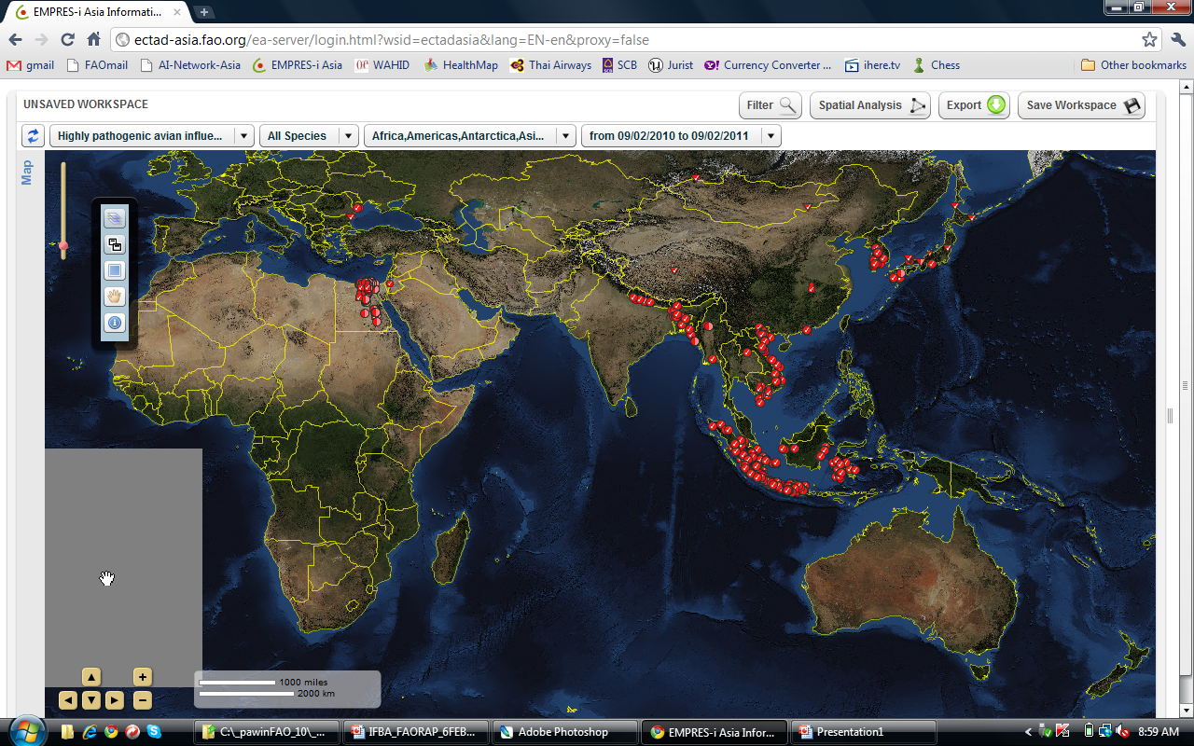
Key Outcomes of Regional Laboratory Network for HPAI Diagnosis
Improved early detection of diseases
Harmonized, accurate and timely diagnosis
Better understanding of disease epidemiology at country and regional level
HI Proficiency Testing Results
2.3.2
2.2
2.3.4
1
2.1
4

Slide 5
FAO-OIE-WHO Collaboration
Vision
A world capable of managing, and ideally, preventing animal and public health risks attributable to zoonoses and animal diseases impacting food security through multi-sectoral cooperation and strong partnerships.
5

Slide 6

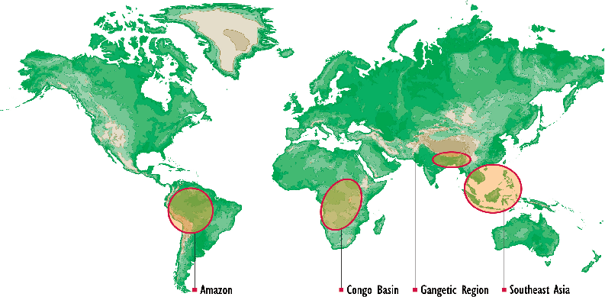
EPT Geographic Coverage
6
6
Notes:
6

Slide 7
Emerging Pandemic Threat Program (EPT)
Early identification of and response to dangerous pathogens in animals before they can become significant threats to human health
PREDICT
RESPOND
IDENTIFY
PREVENT
To implement an early warning system that addresses the role of wildlife in facilitating the emergence and spread of new diseases
To strengthen countries' capacity to identify and respond to new disease outbreaks in a quick and sustainable manner
To support the development of laboratory networks and strengthen diagnostic capacities in those areas thought most likely to be the source of emerging diseases
To build a behavior-change response to infectious diseases and support efforts to characterize high-risk practices that increase the potential for spreading such diseases
7

Slide 8
Global Laboratory Network
A Global Cooperative Network
  To rapidly diagnose normative diseases and emerging pathogens and inform authorities responsible for reporting on animal diseases and unusual epidemiologic events (GLEWS, EMPRESi)
  To support a country's full capability to report listed and emerging animal diseases to OIE
  Investigate events of potential international public health concern for reporting as required by the WHO International Health Regulations (IHR)
8

Slide 9
SE Asia Strategy for
Regional Laboratory Networking
Reaching agreement on priority diseases to be considered
Facilitate and expand functional and sustainable regional laboratory networks
Strengthen regional capacities to diagnose pathogens significant to the region and ability to diagnose emerging and unknown pathogens
Expand platform for information sharing and develop mechanism for sharing of biologic materials
9

Slide 10
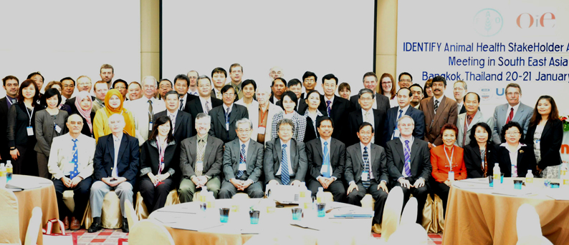
IDENTIFY Animal Health Stakeholders Awareness Meeting
Bangkok, Thailand
20 – 21 January 2011
A total of 61 participants
  CVOs,
  OIE delegates
  Director of national animal health laboratories (Cambodia, China, Indonesia, LaoPDR, Viet Nam, Malaysia, Myanmar, Thailand , Philippines, Bangladesh and Nepal,)
  International reference laboratories,
  Other EPT components and regional partners in disease surveillance and diagnosis.
10

Slide 11
Meeting Background
IDENTIFY Animal Health Stakeholders Awareness Meeting, 20-21 JAN 2011, Bangkok, Thailand
The Global Framework for Transboundary Animal Diseases
  A number of forums / structures that complement each other
FAO/OIE/WHO approach for IDENTIFY
  A need for going beyond HPAI
  Support capacity to diagnose normative diseases in SE Asia through strengthened systems, labs and networks
  This increased capacity to provide improved ability to cope with emerging/unknown issues as a second step
11

Slide 12
IDENTIFY Animal Health Stakeholders Awareness Meeting, 20-21 JAN 2011, Bangkok, Thailand
Future Expectation of Lao Authority to Improve National Animal Health Laboratory
Additional capacity from 2011 up to 2014
Isolation of agent
  Cell Culture
  Embryonated chicken eggs
Pathology
  Histochemical
Molecular Diagnostic technology
  PCR-techniques and sequencing

Slide 13
IDENTIFY Animal Health Stakeholders Awareness Meeting, 20-21 JAN 2011, Bangkok, Thailand
Overall Functionality of Animal Health Laboratories In SE Asia
Advance
Routine
Basic

Slide 14
Prioritization of Animal Diseases
IDENTIFY Animal Health Stakeholders Awareness Meeting, 20-21 JAN 2011, Bangkok, Thailand
Ranking | Pathogen | Diseases
1 | Virus | Avian Influenza
2 | Bacteria | Salmonellosis
3 | Virus | Nipah
4 | Bacteria | Bovine Tuberculosis
5 | Virus | PRRS
6 | Bacteria | Brucellosis
7 | Bacteria | Leptospirosis
8 | Virus | Classical Swine Fever
9 | Virus | Newcastle Disease
10 | Virus | FMD
14

Slide 15
IDENTIFY Regional Laboratory Network Activities
Technical Capacity Building
Development of Guidance, Policy and Training
Laboratory Quality System
Laboratory Networking and Communication
15
Notes:
15

Slide 16
IDENTIFY Regional Laboratory Network Activities
Technical Capacity Building
Improve laboratory physical environment
Improve pathology techniques
Improve diagnosis/surveillance for normative diseases and reporting system
Improve diagnosis/surveillance for emerging diseases
Identify leading laboratories for unidentified samples
Additional laboratory mapping
Organize key stakeholders meeting
16
Notes:
16

Slide 17
IDENTIFY Regional Laboratory Network Activities
Development of Guidance, Policy and Trining
Sustain Laboratory Directors Forum (JICA)
Advocacy for national authority to achieve minimum standard for pathology
Addressing procurement issues – regional stock of reagents
Addressing import permit issues
Support preparation for joint international guidelines and standards for laboratories and promotion of national laboratory policy development
Development of standard operating procedures, guiding policy and training consistent with One Health approach
17
Notes:
17

Slide 18
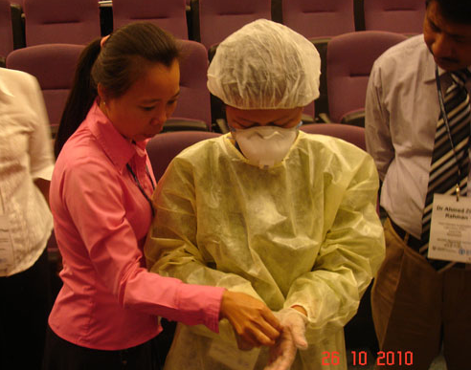
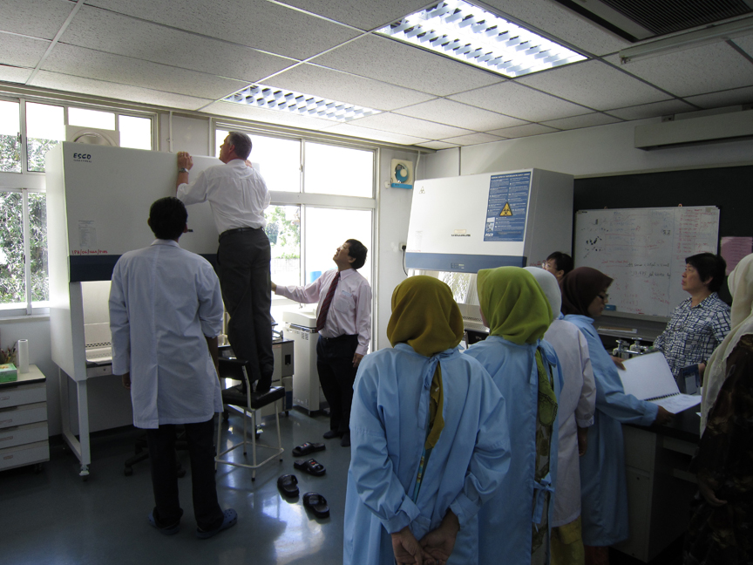
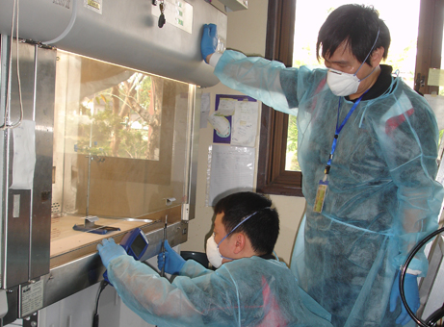
IDENTIFY Regional Laboratory Network Activities
Laboratory Quality System
Support accreditation of laboratories
Improve biosafety & biosecurity
Develop sample referral/shipment protocol
Develop and harmonize diagnostic protocols
Provision of quality assurance reagent and proficiency testing
Support development of in-country proficiency testing programme
18
Notes:
18

Slide 19
IDENTIFY Regional Laboratory Network Activities
Laboratory Networking and Communication
Provide communication platform for the laboratories
Improve IT infrastructure capacity
Assign laboratory focal point
Support existing networks
Support networks for identification of new pathogens in wildlife, domestic animals and humans
Develop FAO/OIE/WHO laboratory twinning initiatives and partnerships
19
Notes:
19

Slide 20
IDENTIFY Regional Laboratory Network Activities
Exposed herd
(Serum)
Sick Animal
(Swab / Tissue)
Sample
Rapid test
Basic / Routine
Laboratories
Confirmation of known disease
POS
NEG
Report
Advance Laboratories
Isolation and identification of unknown agents
NEG
POS
Differential diagnosis
& Report
Further characterization
Reporting
20

Slide 21
IDENTIFY in Context of LaoPDR
Activities In LaoPDR
Biosafety
  Site visit (November 2010)
  BSC certification (January 2011)
  Equipments replacement and maintenance
Regional team visit to follow-up on PT, QA, backstopping
Development of information resource
  Provision of laboratory reference book
Support the development of business plan for BSL3
  Consultant

Slide 22
IDENTIFY in Context of LaoPDR
Involving LaoPDR
Biosafety management training
Harmonization of diagnostic protocols
  Training on diagnostic
  Training on proficiency testing provider
Quality Assurance
  Provision of proficiency testing panel and quality control reagents
22

Slide 23
IDENTIFY in Context of LaoPDR
LaoPDR can request for support
Sample shipment box and shipping cost
Participation in the international conference
Staff exchange
Development of guidelines for selecting fit-for-purpose open-source laboratory information management system (LIMS)
23

Slide 24
Key Issues
Expansion of Regional Laboratory Network for HPAI Diagnosis
  Support capacity to diagnose normative diseases
  Provide improved ability to cope with emerging/unknown issues
Focus on regional approach with countries involvement
Animal health laboratories in LaoPDR
  Currently under development
  Coordination of external inputs
Information sharing and networking
  Linkage between laboratory diagnostic and field epidemiology
  Linkage between animal health and human health laboratories

