Slide 1
Supply Chain Actor Mapping Report
The Mukdahan Corridor across Thailand, Laos and Vietnam
Part 1 – Overview and Thailand Report
December 2010

Slide 2
Qualitative Research: Avian Influenza (AI)
Benefits of Qualitative Research:
Investigates ideas and issues around a topic
Sheds light on what is already known
Triangulation of data allows an overall understanding of the situation
Leads to new dimensions to explore
Objectives of this Study:
Explore triggers and barriers of preventive behavior in commercial actors within the supply chain
Identify risk areas and gain insight into possible intervention strategies
Recognize and provide reasons for weaknesses in biosecurity and preventive behavior
Findings may not be representative of the entire supply chain in each country
Opinion Leaders

Slide 3
Outline
Summary & Recommendations
Lessons Learned
Background & Methodology
Thailand Country Report
Laos Country Report
Vietnam Country Report

Slide 4
Summary & Recommendations
From overview to lessons learned

Slide 5
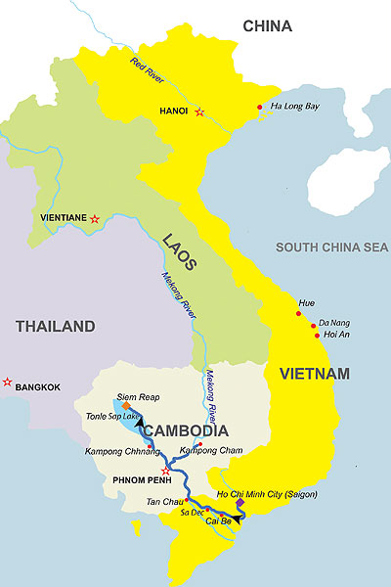
Overview: Supply Chain Actor Mapping Study of Four Sites in Thailand, Laos and Vietnam
Differ in level of biosecurity and preventive behaviors in the supply chain
Vietnam: Relaxed attitude No recent AI outbreak; government vaccination program has fostered complacency
Laos: Strive for better biosecurity. Supply chain actors remember last outbreak
Thailand: Very high biosecurity. Supply chain controlled by large food companies who introduced strict practices
Therefore, “risk direction” appears to be moving from Vietnam to Thailand
Thailand
Large food companies control the supply chain with high level of biosecurity
Vietnam
Low biosecurity practices due to strong belief in AI vaccines
Risk Direction
Laos
Recent outbreaks keeps AI top of mind and commercial farmers strive for better biosecurity

Slide 6
Commitment to AI Prevention by Country Level of commitment: Green=strong Amber= moderate Red= weak
Thailand
Laos
Vietnam
Farmers
Motivated to keep high level of biosecurity as a requirement from food companies.
Farmers
Some have high level of biosecurity to prevent loss of income. Others have misguided beliefs about AI. Need for education.
Farmers
Complacent because AI is not deemed a serious threat due to the belief that vaccinations will remove risk.
Contributors
Controlled by the food companies ensuring high quality in products. One weakness: fresh market vendors.
Contributors
Poorly educated and inexperienced with AI resulting in low biosecurity. Some doubt the disease even exists.
Contributors
Poor biosecurity. Do not see themselves as being part of the problem. Rely completely on quarantine system.
Opinion Leaders
Experienced past outbreaks and brought them under control. Potential for becoming too relaxed and confident.
Opinion Leaders
Farmers need to maintain a high level of biosecurity as a requirement of the food companies.
Opinion Leaders
Believe they have good systems in place but struggle to overcome blind belief in the vaccination and quarantine system.
Thailand: In the forefront, but motivation comes from large food companies seeking to control the supply chain.
Laos: Recent outbreaks have resulted in large farms seeking to improve biosecurity. Contributors are a point of weakness and may need to be dealt with beyond surveillance.
Vietnam: Highest risk due to complacency resulting from existing vaccination and quarantine program.
Opinion Leaders

Slide 7
Potential Danger Routes
Weak links in the supply chain along the Mukdahan corridor may result in transmission of AI
Border areas
Distribution channels
Opinion leaders have an important role to play in terms of supporting communication activities and other initiatives
Thailand
Laos
Vietnam
Farmers
Farmers
Farmers
Contributors
Contributors
Contributors
Opinion Leaders
Opinion Leaders
Opinion Leaders
Opinion Leaders

Slide 8
Recommendations for Communication
Target audiences and messages differ for each country. Further research may be needed to quantify some of the findings, but a general communication strategy is described here:
Vietnam
Barrier: A false sense of security in the vaccination and quarantine system which is reinforced by no recent outbreaks.
One strategy may be to work with the government on other disease prevention programs that would help to prevent AI. For example, Newcastle disease prevention is a priority for farmers and its prevention helps in the prevention of AI.
The target audience: Contributors as well as farmers, with a focus on the medium-sized commercial farms.
Laos
Barrier: Contributors are not economically dependent on poultry. However, recent AI outbreaks have triggered more concern.
Transport workers require biosecurity education. Poultry are stored as cargo on the same bus transport systems used by humans. Review of current campaigns to determine alignment with the threat should be supported by the local governments.
Thailand
Potential threat: In the border area near Mukdahan the perceived threat of AI is greatly diminished and there is strong reliance on the existing surveillance system.
Surveillance system should become more proactive by looking at border activities. Biosecurity of poultry transported from Laos is a risk because poultry is transported across the border relatively unchecked.
Opinion Leaders

Slide 9
Background & Methodology
The qualitative study covered commercial farmers, contributors and opinion leaders, and was in part based on the health belief model

Slide 10
Background
Supply chain actors have different perceptions and beliefs about AI. The extent to which AI is seen as a risk is in part based on experience with the disease. Culture and societal influences also contribute to knowledge and perceptions.
Lack of knowledge can lead to barriers for preventive behavior. This study identifies those barriers, whether real or imagined, as well as possible triggers for preventive action.
As a first step, the health belief model (HBM) was used to determine the different values of the chain actors. This helps to define the context within which barriers and triggers operate and is relevant for formulating appropriate communication strategies.
Perception of AI in terms of risk and need for preventive measures
Barriers to practice AI preventive measures
Cues for behavioral change communication activities

Slide 11
Health Belief Model (HBM)
The HBM is a psychological model that explains and predicts health behaviors by focusing on the attitudes and beliefs of individuals. It is based on the understanding that an individual will act if they perceive that there is an avoidable threat and if they have the means to take the appropriate action. Different types of barriers may occur at each stage and the focus of the communication initiative should be adjusted accordingly.
HBM
Barriers
Communication
AI is believed to be a threat
No
Lack of experience or knowledge
Provide empirical evidence of the threat of AI
Yes
Triggers
Believe that AI can be avoided
No
Lack of knowledge
Educate about preventive action
Yes
Triggers
Recommended actions are effective
No
Misguided beliefs
Boost motivation through influencers such as NGOs, HCWs, etc.
Yes
Triggers
Ability to take recommended actions
No
Financial or other barriers in place
May need physical support/assistance to overcome these

Slide 12
Locations
Thailand
Muang Mukdahan District
Laos
Khanthabouly District
Sepone District
Vietnam
Huong Hoa District

Slide 13
Target Groups & Sample
Farmers
Private sector poultry farmers
Contributors
Transporters
Middlemen
Suppliers
Vendors
Opinion Leaders
Human health care workers
Animal health care workers
Local Governments
Target Group | Thailand | Laos | Vietnam | Total
Farmers | 2 | 5 | 2 | 9
Contributors | 8 | 19 | 8 | 35
Opinion Leaders | 3 | 10 | 3 | 16
Total | 13 | 34 | 13 | 60

Slide 14
Sampling Limitations
Thailand
Supply chain is dominated and controlled by large food companies and all poultry are taken to a central depot before being distributed to the market. Permission was required in order to interview the staff. There were no egg wholesalers in the area as all eggs were brought in from other districts, so the original sampling plan was adjusted.
Laos
In the Sepone area, there are no large commercial farms, so all farm interviews were shifted to Kaisone district. Because the total number of farms were limited, the sampling plan was adjusted by shifting planned interviews to other supply actors.
Vietnam
There are no specialized trucks used for poultry transport. Instead the birds are transported by bus using the public transport system. Transportation is done by the farmers who take the poultry to the market on a motorbike (10-50 birds/trip). The farmers sell poultry directly to restaurants and large functions. There are seldom any middlemen who buy directly from the farmers.
Opinion Leaders

Slide 15
Screening & Recruitment of Respondents
In order to have comparable respondent segments across countries, participants were recruited based on pre-determined screening criteria. The criteria for each segment is shown in the table below. All business owners and workers were required to have a minimum of two years experience.
Respondent Segment | Screening Criteria
Market Vendors | Sell live or dead poultry in the market
Middlemen | Wholesale vendors who sell live poultry to market vendors
Transporters | Transporters of live poultry
Suppliers | Wholesale vendors who sell eggs to market vendors
Private sector poultry producers | Commercial producers of live poultry Must have 100 or more poultry on the farm
Human/Animal Health care workers | Must be the designated person who would be involved with treatment of AI or have experience with the disease
Local Government | Thailand: Mukdahan Provincial Health Office, Disease Control Unit Laos: Provincial Health Department in Savannakhet Vietnam: Quang Tri Sub-Department of Animal Health

Slide 16
Moderator Guide Structure
Moderator guides were developed in cooperation with AED. A different moderator guide was prepared for each target group and the general structure is shown below.
Special effort was made to ensure effective probing. This was achieved by including special instructions and holding separate briefing sessions with the moderators in each country.
Farmers | Contributors | Opinion Leaders
Health concerns in general | Health concerns in general | Health concerns in general
Poultry management | Poultry / Egg trade | Avian influenza concerns
Avian influenza concerns | Avian influenza concerns | Avian influenza knowledge
Avian influenza knowledge | Avian influenza knowledge | Avian influenza practice – potential barriers
Avian influenza practice – potential barriers | Avian influenza practice – potential barriers | Support and influence
Beliefs about Avian influenza – potential triggers | Beliefs about Avian influenza – potential triggers | Perspective to other concerns
Perspective to other concerns | Perspective to other concerns

Slide 17
Thailand Country Report
Muang Mukdahan District, Mukdahan

Slide 18
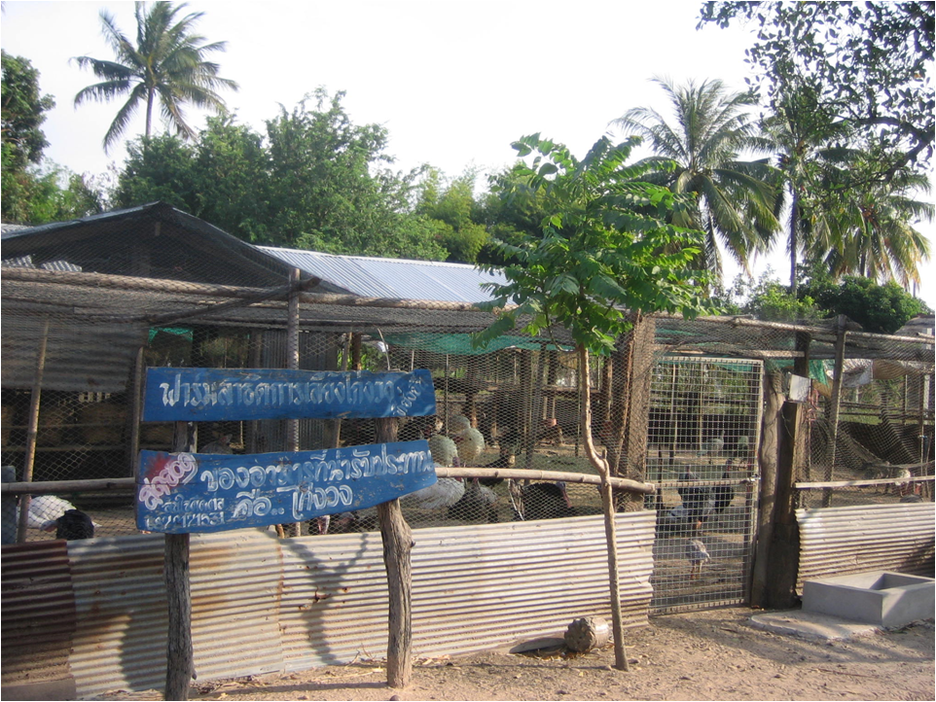
Farmers
Sector 2 commercial farmers with 100 or more live poultry on their farm
Farmers

Slide 19
Farmer Summary: Muang Mukdahan
Farm Management
There are 2 types of farms: Large commercial contract farms and one large turkey farm.
In the past there were three companies who ran large contract farms but now there are only two companies: Gao-Naa and CP.
Snapshot
Motivated by financial risk, contract farms are better at AI prevention than backyard poultry farmers.
Poultry selling is the main income, but most also have their own plantations.
Health Concern
AI is not a serious concern among contract farmers compared to other health issues
Health is less of a concern than economic factors and education.
Health Belief Model
Contract farmers believe AI can be prevented and often have financial support from food companies to ensure prevention practices are followed.
AI Perception
Contract farmers have knowledge about AI and have experienced past outbreaks
Barriers
Financial
Some farms have stopped vaccinating poultry
Triggers
Food companies provide vaccination equipment
Proactive knowledge campaigns
Farmers

Slide 20
Farmers: Snapshot
Mindset
Large contract farms: Motivated to improve socioeconomic status so follow food company policies.
Turkey farm: Motivated to improve the community’s livelihood.
Household income
Large contract farms: Income comes mainly from poultry sales.
Turkey farm: Income from other sources.
Livelihood Concerns
Both the contract farms and the turkey farm have their own plantations.
Success in poultry farming can help to raise the standard of living.
Family Situation
Large contract farms: Family members, i.e. educated children, provide support
Turkey farm: Positive socioeconomic status has led to good technical farming skills.
Farmers

Slide 21
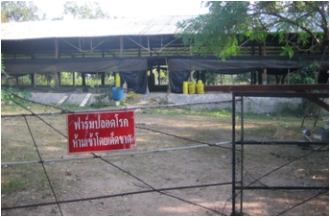
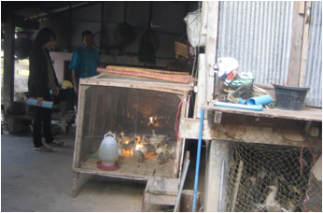
Poultry Management: Bio-Security
Contract Farms
High standards of biosecurity controlled by large food companies
Turkey Farm
Good preventive practices but not at the same level as the contract farms
Farmers

Slide 22
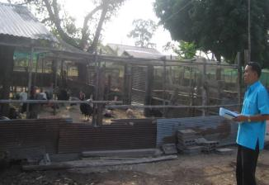
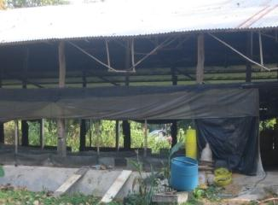
Poultry Management
Large Contract Farms
Old standard:
Poultry checked for AI by Animal Healthcare Workers before being sold.
Laboratory confirmation of health required prior to sale.
New standard: (practiced by some farms)
No laboratory testing is required if farms are certified by the Livestock Department.
Certification is for one year.
Farms present proof of certification to the Livestock Department to obtain approval for slaughter.
Farms weigh the poultry and the food company manages transportation.
Farmers

Slide 23
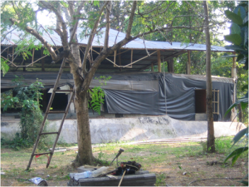
Poultry Management
Large Contract Farms
Company Control via telephone:
The main office in Bangkok coordinates with the different provincial branch offices. Farmers follow company policies and standards.
Example: One farm in Mukdahan
Poultry weight managed by Roi-Et office
Food control managed by Roi-Et office
Temperature managed by Roi-Et office
Accounting managed by Udon Thani office
Slaughter managed by Sakolnakorn office
Preventive Practices on Farms:
Automated disinfectant equipment to control disease.
Burns dead poultry.
Informs food company of any abnormalities.
Food company administers vaccines, monitors temperatures and weights, and cleans the poultry houses.
Safety fences enclose the poultry houses.
Farmers

Slide 24
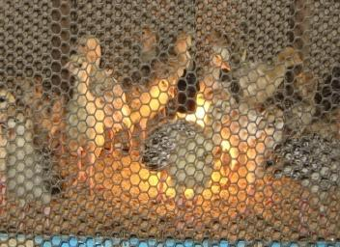
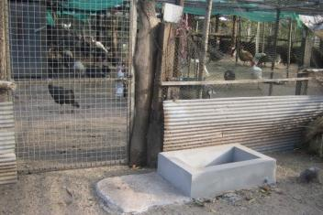
Poultry Management
Turkey Farms
Preventive Practices:
During feeding times, a large net prevents other birds from flying into the turkey flock.
Adult poultry are released twice a day for feeding and exercise.
The poultry house is cleaned every seven days.
Farmers

Slide 25
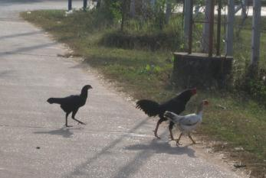
Other Observations/Potential Risk
Muang Mukdahan District: Collaboration among healthcare workers, local government, and large food companies has led to good disease control and prevention.
One potential risk:
Freely roaming backyard poultry.
Farmers

Slide 26
Hierarchy of Needs: Position of Farmers
Differences in Aspirations of Farmers
Contract farmers raise poultry to improve their economic status: Social Needs
The turkey farmer aims to improve his economic status, but as a community leader, he also seeks to gain acceptance and admiration from people in the community: Esteem
SA
Esteem
Social Needs
Safety Needs
Physiological Needs
*SA=Self Actualisation
Farmers

Slide 27
Health Concerns of Farmers
No. 1
Cancer
The farmers’ leading health concern is cancer. They believe that people with cancer die shortly after diagnosis. A chronic disease as a major health concern indicates that farmers in Thailand are probably better off than farmers in other countries.
Diarrhea and hepatitis are of concern because of the prevalence of these diseases in the community.
Fever is believed to spread easily, especially among children. Some believe that swine flu (H1N1) has affected people who work in Bangkok, but that it can be cured.
No. 2
Gastritis and diarrhea
No. 3
Enteritis and hepatitis
No. 4
Opisthorchiasis
No. 5
Fever
Farmers

Slide 28
Relationship of AI to other Major Concerns
Economic status is the leading concern of farmers. They struggle with repaying debt incurred when they borrowed money from large food companies to purchase farm equipment.
Education of children is the 2nd major concern.
Farmers are less concerned about health, believing that most illnesses are transient and short-lived. In comparison to other diseases, there is less concern about AI. They have never experienced an AI outbreak in humans.
Social concerns rank the lowest. Small villages are safe and secure, and people help each other.
Economic
Education
Health
AI
Social
Farmers

Slide 29
Health Belief Model (HBM)
Farmers are at the 4th level of the HBM-Able to take recommended actions:
Access to good equipment
Can take out loans with the large food companies if needed
Potential Risks:
The turkey farm no longer vaccinates since there has been no recent AI outbreak.
Backyard poultry farmers are a risk due to significantly lower levels of bio-security.
HBM
AI is believed to be a threat
Yes
Triggers
Believe that AI can be avoided
Yes
Triggers
Recommended actions are effective
Yes
Triggers
Ability to take recommended actions
No
Financial or other barriers in place
May need physical support/assistance to overcome these
Farmers

Slide 30
Farmers’ Perceptions About AI
Knowledge about AI comes from local government PSAs, aired during past outbreaks.
Farmers believe that poultry deaths of about 1% are normal; massive and rapid deaths are more serious. In such cases, animal healthcare workers should be notified.
Outbreaks
Most believe that AI symptoms in humans include high fever and shortness of breath.
Symptoms
If poultry becomes sick, it is more likely to be from general illnesses such as cholera, smallpox, or pullorum.
If AI attacks poultry, the impact can be more severe than with other diseases. However, farmers believe that the government can control and prevent any potential outbreak.
Other Beliefs
Farmers

Slide 31
Farmers’ Attitudes Towards AI Prevention
Large Contract Farms
Believe it is important to have good preventive practices which are enforced and controlled by the large food companies.
Large Turkey Farm
Has vaccination equipment to prevent AI but since there have been no recent outbreaks, the farmer is no longer vaccinating.
However, at both farms:
masks, gloves, wash clothes and hand washing are used around poultry.
fences or nets are in place to separate poultry from humans and other animals.
poultry houses are kept clean and are disinfected as instructed by the animal healthcare workers.
Farmers

Slide 32
Few Barriers to AI Prevention
Experience
Farmers have not experienced outbreaks in their own district, but they have witnessed past outbreaks in nearby districts in 2004 and 2007. They have not seen AI transmitted to humans.
Knowledge
Farmers have learned about AI from PSAs as well as from government and health care workers in the local area. The farmers appear to be well informed.
Belief
Famers believe that AI prevention is possible since they saw the government quickly stop past outbreaks and no further outbreak has occurred.
Financial
Farmers may lack financial resources themselves, but have support from the food companies and can obtain loans to buy equipment, etc.
Farmers

Slide 33
Triggers for Behaviour Change and AI Prevention
Most important trigger: Standard guidelines set by the large food companies.
The food companies send staff to train farmers on AI prevention and other practices.
The companies provide protective clothing and other equipment.
Health care workers are proactive and help raise awareness about AI and other diseases in the local area.
Past government PSAs appear to have been effective.
Farmers

Slide 34
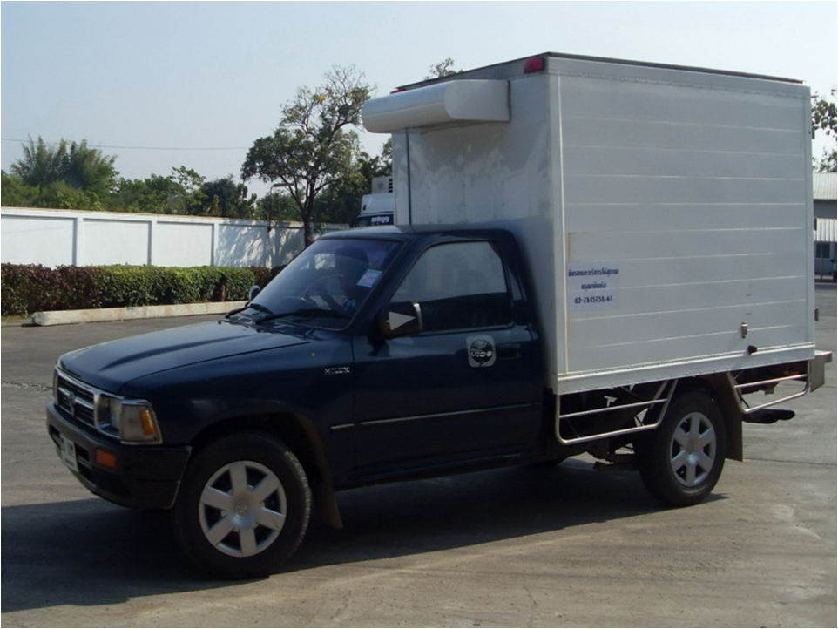
Contributors
Include poultry depot for live poultry, contract transporters, and vendors of live poultry in the fresh market
Contributors

Slide 35
Contributors: Summary
Farm Management:
Vendors buy poultry and eggs from large food companies for both wholesale and retail.
Transporters are regular staff of large food companies or sub-contractors.
Middlemen are always part of the large food companies.
Snapshot
Contributors are controlled by animal healthcare workers and the large food companies.
Health Concern
Contributors believe AI is dangerous but the risk of an outbreak is very low. Because many of the contributors are contractors for the large food companies, they follow strict guidelines regarding bio- security.
Health Belief Model
Contributors have the means to follow preventive practices
AI Perception
Contributors are knowledgeable about AI from experience with past outbreaks as well as through information received via media.
Barriers
Finance is the only potential barrier for prevention. Vendors, who are less controlled by the large food companies, do not use their own money to buy preventive equipment.
Triggers
The food companies provides some equipment for AI prevention.
Increased awareness has come from government PSAs and healthcare workers.
Contributors

Slide 36
Contributors: Snapshot
Mindset
Contributors believe they have less risk of AI than farmers and are less concerned about it than other diseases encountered in the market.
Household income
Contributors main income comes from the poultry business. Although it is hard work, they do it because they are familiar with the work and they can earn a good income.
Family Situation
Contributors have an important role in their family as the main, and in most cases, only, wage earner.
Livelihood Concerns
Business owners are economically stable. The work is hard and schedules can be irregular, but they balance their work with other areas of their lives.
Contributors

Slide 37
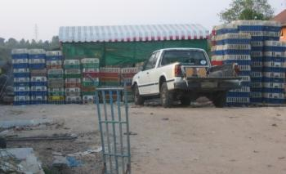
Poultry & Egg Trade
Vendor Management
Management:
Poultry and eggs come from different, large companies in several provinces in north-eastern Thailand.
Most vendors have slaughterhouses regulated by the Livestock Department.
Daily, vendors buy, slaughter and sell poultry to the fresh market.
Preventive Practices:
Workers wear protective clothing and use clean equipment when slaughtering the poultry.
They securely pack fresh poultry and eggs in separate clean boxes before transporting them to the market.
Animal Healthcare Workers disinfect the slaughterhouse every week.
Trucks for poultry and eggs are checked and cleaned according to food company standards.
Small slaughterhouse with truck and boxes for transporting live poultry
Contributors

Slide 38
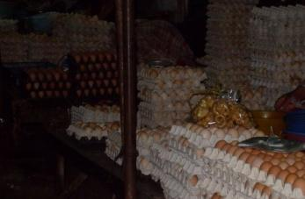
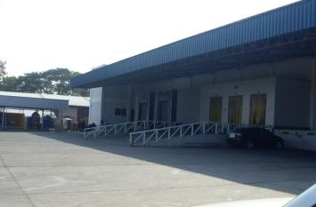
Observations: Few Vulnerable Areas
Egg suppliers observation
Egg suppliers from large food companies have good management standards.
Very rare to find AI in this part of the supply chain.
Eggs in Market
Middlemen observation
Only large food companies are permitted by the Livestock Department to transport live poultry and sell to the market.
Strict cleanliness and safety standards are met.
Very rare to find any diseases.
Distribution Center
Contributors

Slide 39
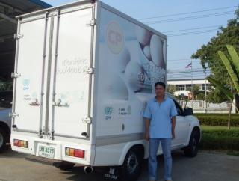
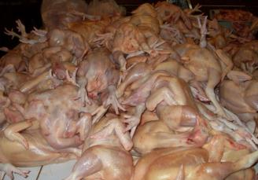
Observations: Few Vulnerable Areas
Transporters observation
Transporters shift poultry and eggs from farms or from distribution centres managed by large food companies. They follow the companies’ standards regarding disease safety and cleanliness.
Vendors observation
Vendors, with permission from the Livestock Department, sell poultry that they buy from large food companies. The vendors slaughter poultry according to set standards and controls.
Contributors

Slide 40
Hierarchy of Needs: Position of Contributors
Aspirations of Contributors
Most are motivated to work hard in order to meet social and esteem needs.
Some worry that their health may be affected, but they continue working because they earn good wages resulting in a good standard of living.
SA
Esteem
Social Needs
Safety Needs
Physiological Needs
*SA=Self Actualisation
Contributors

Slide 41
Health Concerns of Contributors
No. 1
Cancer
Cancer tops the list of health concerns. It is seen as a dangerous disease which cannot be prevented.
Heart disease is next and it is believed to be caused by insufficient rest. Death can be very sudden.
Back problems are a concern among poultry drivers who load and unload poultry.
Eye diseases are a concern for drivers who drive at night.
Hypertension is a concern because it is believed to be prevalent.
AI was rarely mentioned, but vendors are concerned about the cleanliness in the market for non-poultry products such as pork and vegetables.
No. 2
Heart disease
No. 3
Back Problems
No. 4
Eye Diseases
No. 5 Hypertension
Contributors

Slide 42
Relationship of AI to other Major Concerns
Economic
Economic status is the leading concern for contributors. Family income is needed in order to pay for expenses and, like the farmers, many of the contributors have debt.
Education for children is the second concern. They expect to send their children away to study so that they will find a good job in the future. They desire different careers for their children.
All are concerned about health. Regular exercise is valued unless they are too tired.
Some believe AI is more dangerous than other diseases because there is no cure. Some do not fear AI because they believe preventive practices are in place.
Some concerns exist about morality. The belief is that if they are socially good, their children will have a good education and a good life.
Education
Health
AI
Social
Contributors

Slide 43
Health Belief Model (HBM)
Contributors are at the 4th level of the HBM-Able to take recommended actions.
As with farmers, contributors are well informed and believe AI can be avoided.
They may lack financial resources and vendors may be a bit careless at times, but overall, there are few barriers.
HBM
AI is believed to be a threat
Yes
Triggers
Believe that AI can be avoided
Yes
Triggers
Recommended actions are effective
Yes
Triggers
Ability to take recommended actions
No
Financial or other barriers in place
May need physical support/assistance to overcome these
Contributors

Slide 44
Contributors’ Perceptions About AI
During the first AI outbreak, fear of increased susceptibility in children led a vendor to send her granddaughter away. She now believes that AI is not easily transmitted.
Contributors believe sick poultry will not enter the market because the farms will cull any sick poultry.
Disease Transmission
Most believe that AI symptoms in humans include sneezing, shortness of breath, high fever, and loss of appetite.
Symptoms
Outbreaks
Some transporters witnessed AI in Khonkaen in 2004.
People in rural areas with backyard poultry represent the highest risk.
Children and elderly with less education are at increased risk, especially those living in close proximity to poultry.
Contributors

Slide 45
Contributors’ Attitudes Towards AI Prevention
Slaughterhouse: Vendors maintain good preventive practices. Animal healthcare workers visit and disinfect the area every week.
Fresh poultry market: Vendors worry less, believing disease comes from live poultry. However, they maintain clean stalls and poultry.
Vendors
As contractors for large food companies, transporters practice good prevention:
Keep live and fresh poultry separate.
Ensure the truck is kept at the correct temperature.
Follow a specific time schedule to ensure the poultry arrives fresh.
Transporters
Large food companies coordinate with farmers, vendors, transporters and animal healthcare workers to ensure all standards are followed.
Middlemen
Contributors

Slide 46
Few Barriers to AI Prevention
Experience
Some contributors, especially transporters who travel to many provinces, have experienced AI outbreaks while others have only heard about AI through the media.
Knowledge
Contributors have gained knowledge from setting up their businesses, being advised by healthcare workers on how to practice prevention, and from following the standards set by the large food companies.
Belief
Contributors believe that AI can be avoided by following the advice from animal healthcare workers as well as the standards set by the food companies.
Financial
Smaller poultry businesses lack financial resources to take all preventive actions. Some workers in small slaughterhouses, for example, do not wear protective clothing.

Slide 47
Triggers for Behaviour Change and AI Prevention
Large food companies provide training on how to prevent disease.
The food companies provide clothes and equipment to contractors.
Healthcare workers are proactive and help educate about preventive methods.
Media and PSAs, in response to past AI outbreaks, have been effective in increasing awareness.
Contributors

Slide 48
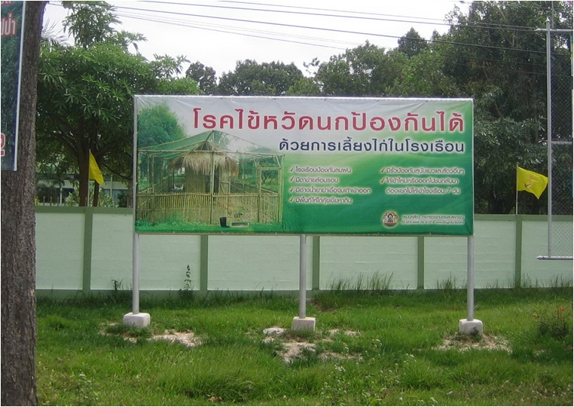
Opinion Leaders
Human health care workers, animal health workers and local government officials
Opinion Leaders

Slide 49
Opinion Leaders: Summary
Snapshot
Opinion leaders know that AI is dangerous but believe that they can control it. They are not concerned about prevention.
Health Concerns
Heart disease and diabetes are considered major health concerns.
AI is of less concern compared to other health risks.
Health Belief Model
Opinion Leaders believe AI can be prevented. However, the government has limited budget for AI prevention programs.
AI Perception
Opinion Leaders are knowledgeable about AI and have learned from past outbreaks.
Initiatives
Past responses have been swift with implementation of relatively good controls and preventive measures.
Triggers
Being rewarded for good work and for being a good practitioner.
Opinion Leaders

Slide 50
Opinion Leaders: Snapshot
Mindset
Many believe AI is dangerous but that government can control it.
People do not fear AI.
Role in Community
Healthcare workers and local governments aim for prevention and control by educating the community through training sessions and educational brochures.
Livelihood Concerns
Many people in rural areas have less concern about health, instead focusing on economic issues.
However, people will cooperate with local government and healthcare workers to prevent disease if needed.
Community Situation
Healthcare workers and local government work closely with local communities continually reinforcing messages.
Changes in behaviour require time.
Opinion Leaders

Slide 51
Health Concerns of Opinion Leaders
Opinion leaders believe heart disease is the major concern because it cannot be cured.
The second major concern is diabetes, which, like heart disease, is becoming more prevalent.
Dengue fever is of concern because it occurs regularly in rural areas during the rainy season.
People in Muang district often have diarrhea.
Malaria is a serious disease in Mukdahan especially in and near forest areas.
Opinion leaders point out that while these diseases are concerning, most people carry on as normal and do not worry about how to prevent them.
No. 1
Heart disease
No. 2
Diabetes
No. 3
Dengue fever
No. 4
Diarrhea
No. 5
Malaria
Opinion Leaders

Slide 52
Relationship of AI to other Major Concerns
Economic
Most opinion leaders are concerned with economic livelihood. Only when people become more wealthy do they become more concerned about their health. People with less money are more concerned about their work.
Education for children is ranked higher than health.
Those concerned about health will follow the advice of local government and healthcare workers. If they are sick they worry about missing work and paying for treatment. If children are sick they cannot go to school.
Seeking health care to treat disease is far more common than disease prevention.
AI does not have a high priority compared to other diseases. Most do not fear AI because they believe it is not easily transmitted. They are more afraid of rabies.
Education
Health
AI
Social
Opinion Leaders

Slide 53
Health Belief Model (HBM)
HBM
Opinion leaders are at the 4th level of the HBM- Able to take recommended actions.
They are experienced and knowledgeable.
One potential risk is the lack of urgency about AI.
AI is believed to be a threat
Yes
Triggers
Believe that AI can be avoided
Yes
Triggers
Recommended actions are effective
Yes
Triggers
Ability to take recommended actions
No
Financial or other barriers in place
May need physical support/assistance to overcome these
Opinion Leaders

Slide 54
Past AI Outbreaks
2004
2007
First outbreak occurred in the Mukdahan area.
Cock fighting on a small farm near the market in the Muang district.
Investigation by The Livestock Department revealed that the farmer fed the fighting cocks chicken scraps, left over from the market.
Few poultry (10 – 20) were infected.
The farm has since closed down.
This was the second occurrence in the Muang district.
Occurred in the Training Center for Career Development, which trains people in poultry farming.
The center has since stopped its activities and the compound has instead become a holiday resort.
Opinion Leaders

Slide 55
Opinion Leaders’ Perceptions About AI
Risk
Lao Border
Mukdahan District borders Laos resulting in an east-west economic corridor. After the second Thai-Lao friendship bridge was built in the Muang District, poultry could be transported between the two countries. About 60,000 eggs and 7,000 poultry were exported to Laos in 2010.
Risk of disease transmission is higher here compared to non-border areas because:
People in the two countries make frequent trips across the border.
It is easy to bring poultry across the border.
Cock fighting is popular in both countries. In March 2007, there was an outbreak of AI near the Thai-Lao friendship bridge in Mukdahan. The cause of this outbreak was determined to be cock fighting birds brought in from Laos.
Lack of Vaccine Use
Smaller farms do not vaccinate poultry. Past outbreaks led to stockpiling of vaccines, but this does not occur now.
Cock Fighting
Cock fighting can be a source of AI disease because the cocks roam freely.
Opinion Leaders

Slide 56
Past AI Prevention Initiatives
Healthcare workers
Destroy Poultry
2004 outbreak led to the culling of all poultry within a 50 kilometer area.
Current practice is to only cull poultry on the same farm when there is risk of coming in contact with dead poultry. The disease observation area is 1 km from the dead poultry location. The area 5 km out is controlled by restricting transfer of poultry. The area is monitored until the situation is safe.
Campaigns
The Livestock Department educational campaign annually targets 100 high school students in order to raise awareness about AI.
MOU
with Government
The Provincial and District AI Prevention and Control Committee:
Stimulates network building
Performs X-rays in risk areas 2x/year and inspects poultry farms
Informs animal healthcare workers of any suspicions.
Opinion Leaders

Slide 57
Past AI Prevention Initiatives
Local Governments
Monitoring system
Local governments work with animal healthcare workers and carry out farm visits to inspect and check for signs of AI.
Campaigns
Media launch of PSAs: Informational brochures and announcements through community radio.
Seven districts in the area have pre-arranged plans on what to do during outbreaks. Various organizations and partners have pre-assigned tasks.
The ‘Big Cleaning Day’ is a proactive campaign held in November, February, May and August each year. The cleaning day is held in high risk areas such as the Khong river, slaughterhouses, areas with high levels of poultry deaths, poultry markets, and national park areas with sensitive bird life.
Farmers keep their farms clean and livestock staff come regularly to spray disinfectant.
Opinion Leaders

Slide 58
Opinion Leaders’ Attitudes Towards AI Prevention
Healthcare Workers
The Livestock Department has a project plan for 2010 to develop efficient poultry farming with a budget to cover a total of 28 farms. Key aspects of the plan include:
Farmers must build poultry houses.
Farmers must use a net to prevent wild birds from coming in contact with the poultry.
Disinfectant use whenever poultry is shifted in or out of the poultry house.
Education
Campaigns
AI outbreaks have not occurred in Thailand for more than 400 days and people may become less concerned. Preventive actions may be less likely to occur. Healthcare workers, especially those involved with livestock in Mukdahan near the border, must continue awareness building about AI and promoting poultry vaccines.
Opinion Leaders

Slide 59
Opinion Leaders’ Attitudes Towards AI Prevention
Local Government
Surveillance System
The government has a surveillance system managed by several surveillance rapid response teams. Their work includes the continuous monitoring of illnesses within the response area. If an infected person is found to have come in contact with poultry, the local government will investigate and find the best solution.
Opinion Leaders

Slide 60
Few Barriers to AI Prevention
Experience
There have been 2 AI outbreaks in poultry but none in humans. Both times the disease was brought under control.
Knowledge
Local governments and healthcare workers work closely with local communities to educate them about AI prevention. There appears to be more focus in high risk areas.
Beliefs
Media, local government and healthcare workers have influence and can provide advice. Messages are trustworthy and help to strengthen beliefs about AI.
Financial
People are more concerned about jobs rather than health. AI is not feared and there is a belief that preventive methods in place are effective.
Opinion Leaders

Slide 61
Triggers for Preventive Practices
Local governments and health care workers feel successful and proud that no outbreaks have occurred in 400 days. Past outbreaks have been curbed and through collaboration with large food companies, resources have been put in place to ensure good standards of prevention.
It is clear that the Mukdahan area is moving towards a more modern society with the poultry supply chain now operating according to Western business philosophies. A real trigger for AI prevention is the possibility of economic growth and the opportunity for corporate wealth. The quality control standards that follow have helped to stimulate AI prevention.
Opinion Leaders

